Slide 1
Digital Portfolio
STUDENT NAME: GOWTHAM HARSAVARDHANAN.B
REGISTER NO AND NMID:222405932 7E2F258B0DF4AA49DFA4C03429F84DC1
DEPARTMENT: B.SC COMPUTER SCIENCE
COLLEGE: SRM ARTS AND SCIENCE COLLEGE
UNIVERSITY: MADRAS UNIVERSITY

Slide 2
BUILDING A PERSONAL WEBSIWEBSITE USING HTML,CSS,AND JAVASCRIPT
PROJECT TITLE

Slide 3

PROBLEM STATEMENT
Many students and professionals lack an online presence to showcase their skills, projects, and achievements effectively. A personal website helps in creating a digital identity and portfolio.

Slide 4

PROJECT OVERVIEW
This project demonstrates how to build a personal portfolio website using:
• HTML for structure
• CSS for styling
• JavaScript for interactivity
It provides a platform to showcase projects, skills, and contact details.

Slide 5

End Users
• Students
• Job Seekers
• Freelancers
• Professionals

Slide 6
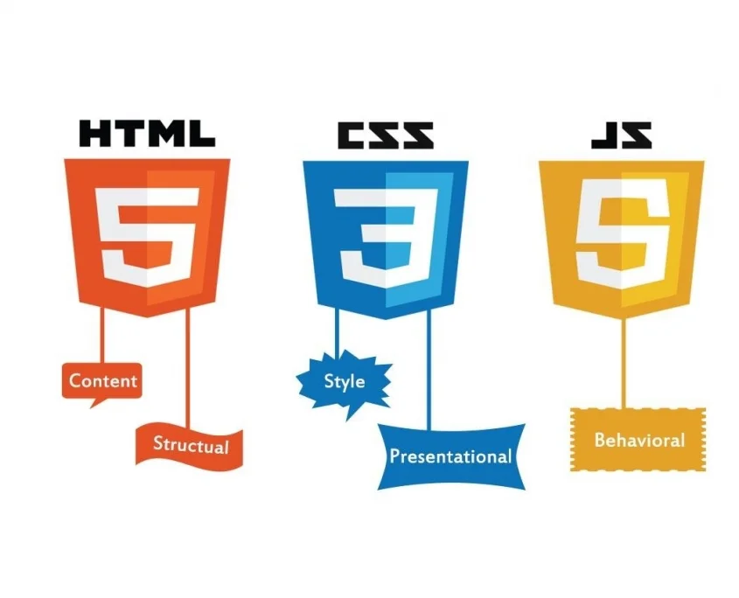
TOOLS AND TECHNOLOGIES
• HTML5
• CSS3
• JavaScript (ES6)
• Code Editor (VS Code)
• Git & GitHub
• Browser Developer Tools

Slide 7
PORTFOLIO DESIGN AND LAYOUT
• Responsive design for mobile and desktop
• Simple and clean navigation
• Sections: Home, About, Projects, Contact
• Consistent theme with CSS
• Use of modern web design practices

Slide 8
FEATURES AND FUNCTIONALITY
• Interactive navigation menu
• About Me section with personal details
• Project showcase with images and descriptions
• Contact form with validation
• Responsive layout
• Smooth scrolling and animations

Slide 9

RESULTS
• Successfully built a personal portfolio website
• Showcases projects and skills
• Provides an online presence
• Example screenshots of the website layout and design
3/21/2024 Annual Review
9

Slide 10
GITHUB LINK
https://github.com/gawthamharsavardhananb-gif/Gowtham.git

Slide 11
A personal website is a powerful tool to highlight your skills and achievements. It enhances your visibility and helps in career opportunities.
CONCLUSION

